Slide 1
EmpowHer
EmpowHER: Empowering Girls for Corporate Excellence
Soft Skill Curriculum - DevOps

Slide 2
Agenda
What is DevOps?
Why is DevOps Needed?
How is DevOps different from traditional IT
Why is DevOps used?
How is DevOps different from Agile? DevOps Vs Agile
DevOps Tools Chain
Who is a DevOps Engineer?

Slide 3
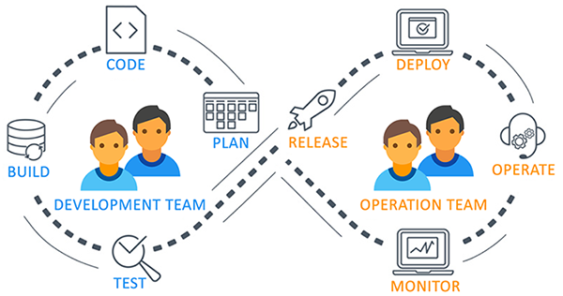
What is DevOps?
DevOps is an iterative process which represents a culture of Developers (Dev) and Operations (Ops) working hand in hand to seamlessly move code from creation to operation in the quickest possible time. Tools enable this objective in an easy fashion and allow us automate workflows, collaborate at all any part of the flow (allowing for quicker feedback), and providing clear well defined audit controls

Slide 4
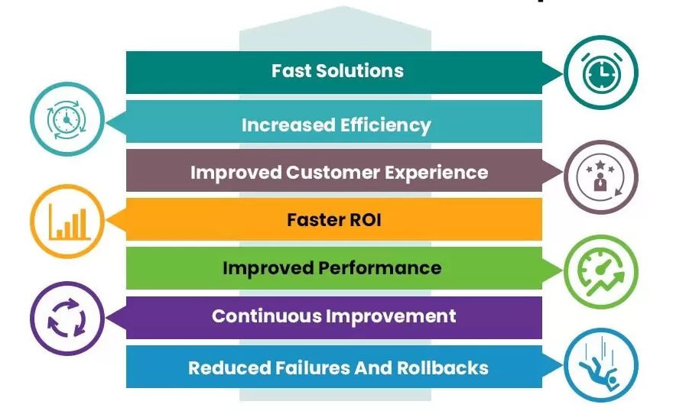
Why is DevOps Needed?

Slide 5
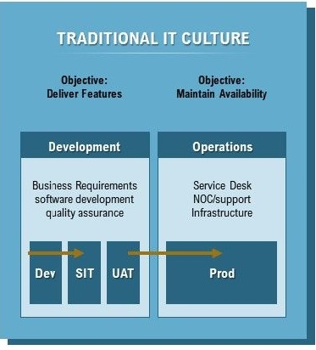
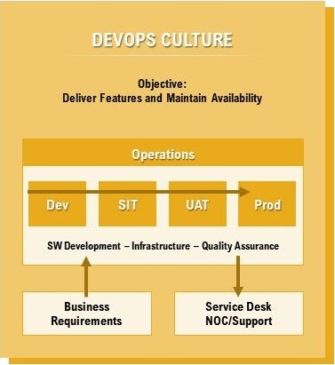
How is DevOps different from traditional IT

Slide 6
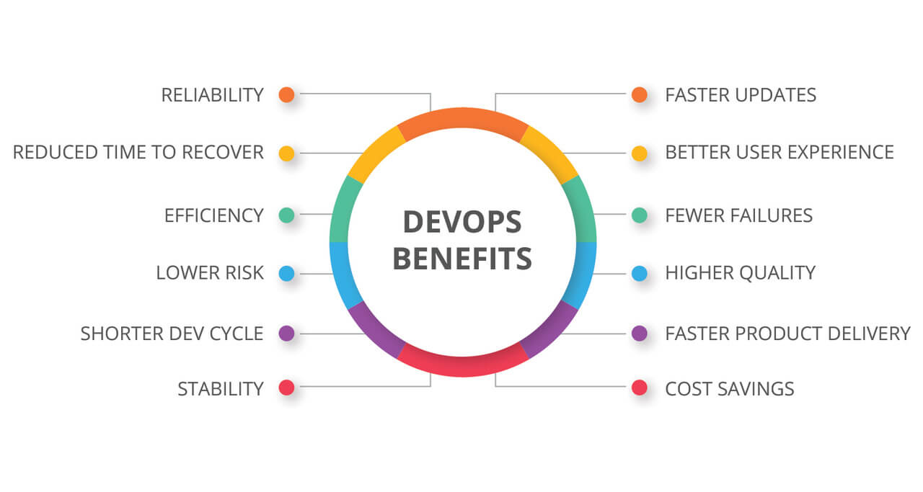
Why is DevOps used?

Slide 7
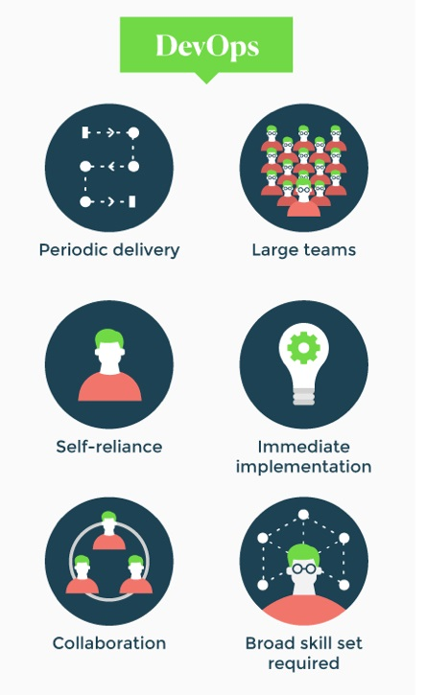
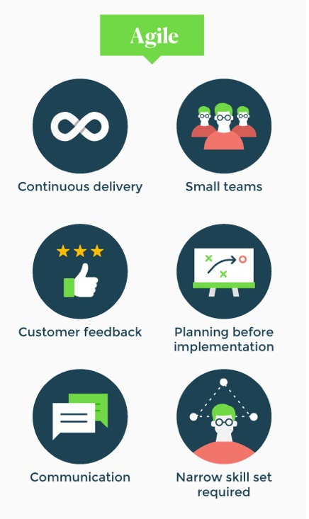
DevOps Vs Agile
Vs

Slide 8



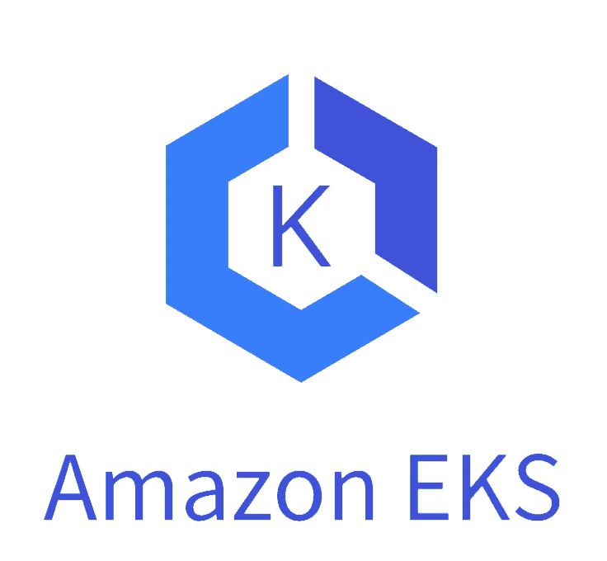


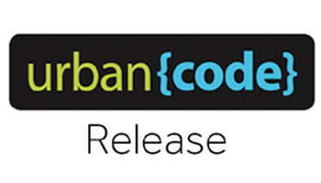
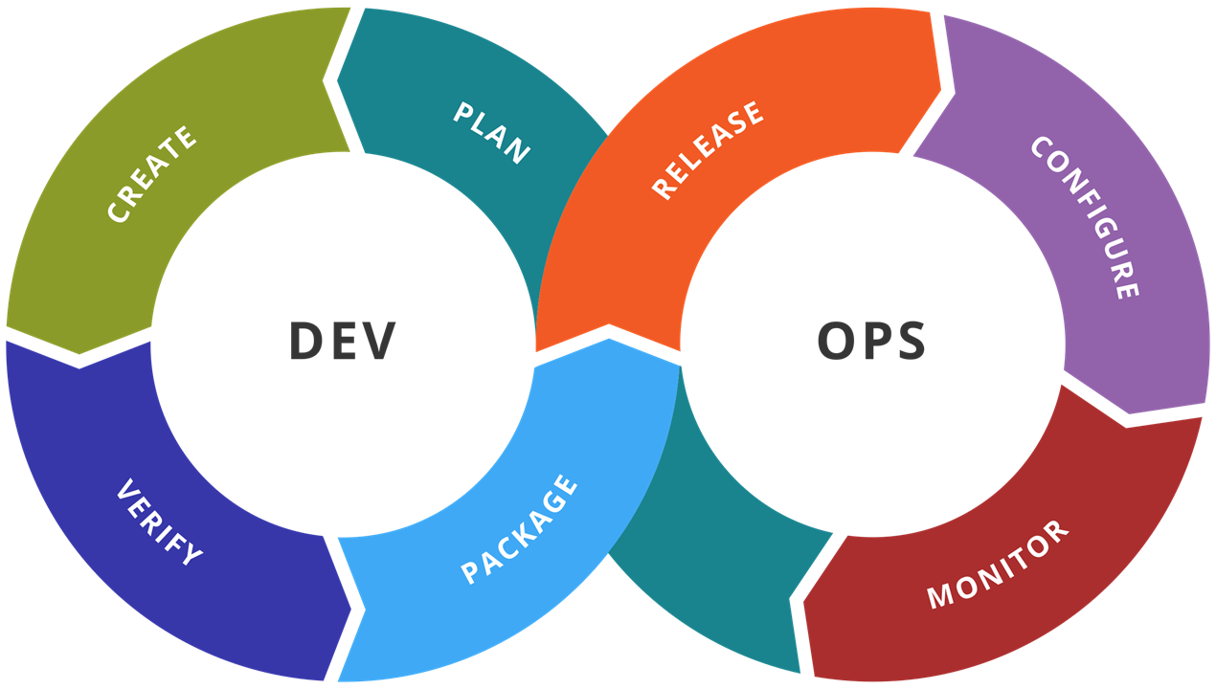
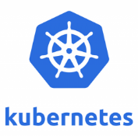



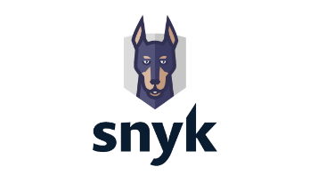
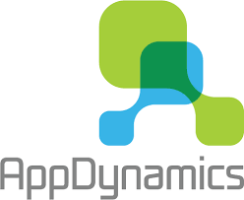





DevOps Tool Chain

Slide 9
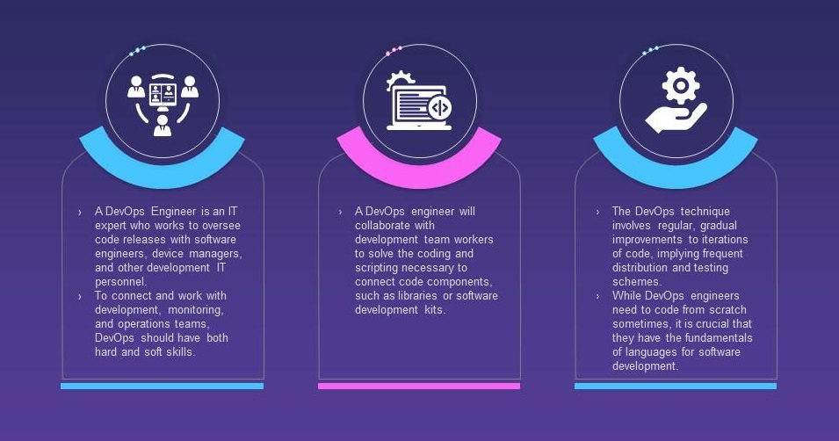
Who is a DevOps Engineer?

Slide 10
Appendix
Github | https://github.com/
Jenkins | https://www.jenkins.io/
Maven | https://maven.apache.org/
Jira | https://www.atlassian.com/software/jira
Argo | https://argo-cd.readthedocs.io/
Amazon EKS | https://www.amazonaws.cn/en/eks/
Kubernetes | https://kubernetes.io/
Amazon ECR | https://aws.amazon.com/ecr/
SonaType Nexus | https://www.sonatype.com/
Docker | https://www.docker.com/
Cypress | https://www.cypress.io/
Snyk | https://snyk.io/
SonarQube | https://www.sonarsource.com/products/sonarqube/

Slide 11
Questions?

Slide 12
Thank You

